Slide 1
Security Assertion Mark-up Language
SAML 2.0 – ASP.NET
This application delegates the user authentication & authorization
to Identity Providers (SingPass/CorpPass)

Slide 2
Modules included
Activants Service Provider ( Web Service ) - C# .NET MVC & C# .NET Web Forms
Initiate Single Sign On
Receive Single Sign On
Initiate Single Logout
Receive Single Logout
Demo Application for testing Activants Service Provider C# .NET MVC

Slide 3


Activants Service Provider
Sharing metadata between SP and IDP
Generate SP’s metadata and send it to IDP for configuration.
Request for IDP’s Metadata and configure it in our configuration files.
SP metadata contains SP’s public key and related information
IDP metadata contains IDP’s public key and related information
Service Provider
Identity Provider
SP Metadata
IDP Metadata
SP’s Public Key
IDP’s Public Key

Slide 4
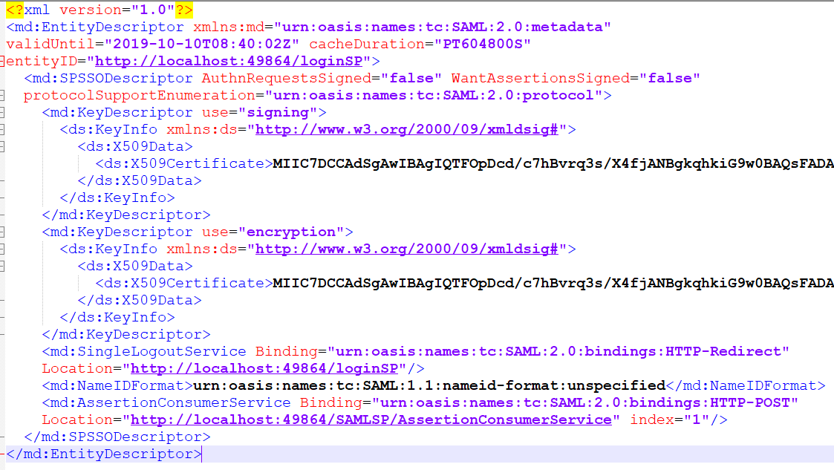
Activants Service Provider
Sample SP metadata
What it contains ?
Entity ID
Public key
Login URL
Logout URL
Type of bindings
Other info

Slide 5
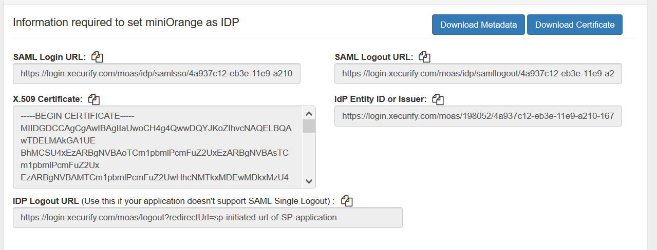
Activants Service Provider
Sample IDP metadata (xecurify.com)

Slide 6
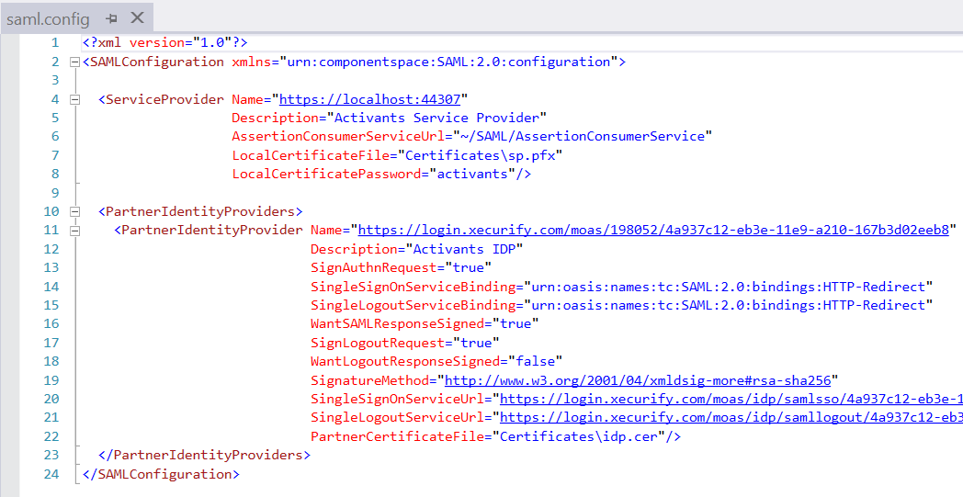
Activants Service Provider
Sharing Metadata and Configuration

Slide 7
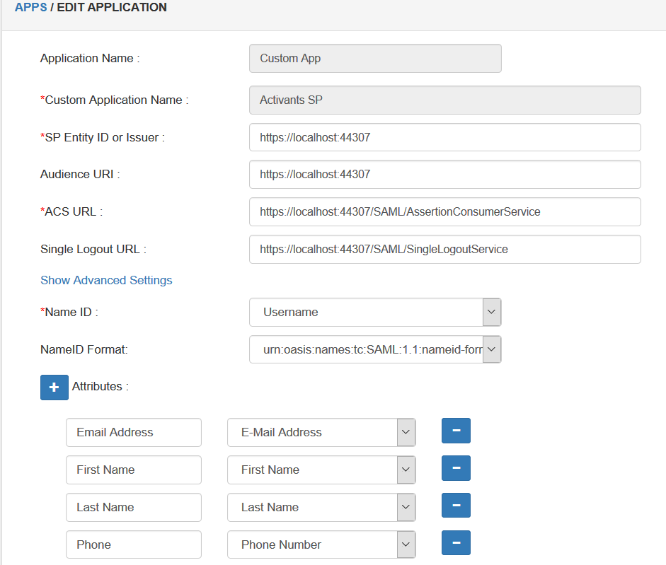
Configuration of SP metadata in IDP

Slide 8
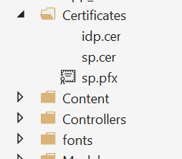
Activants Service Provider
Sharing Metadata and Configuration
idp.cer : IDP’s public key to decrypt the package sent by IDP
sp.cer : Public key shared with IDP to help them decrypt the package signed by SP
sp.pfx : For signing/encrypting the request or response.

Slide 9
Activants Service Provider
Overall view
❷
IDP authenticates SAML request/SP’s signature by
SP’s public key
❶
SAML Request
Digitally signed by SP’s private key
Service Provider
Identity Provider
SP’s Private Key
IDP Metadata
IDP’s Private Key
SP Metadata
IDP’s Public Key
SP’s Public Key
❹
SP authenticates SAML response/IDP’s signature by
IDP’s public key
❸
SAML Response
Digitally signed by IDP’s private key

Slide 10

Activants Service Provider
Process flow (Http Redirect Bindings)
SERVICE
PROVIDER
IDENTITY
PROVIDER
❻
Supply
resources
Assertion Consumer Service
Single Sign On services
❶
Try to Access
Resources
❺
SAML assertion
<Response>
❹
User
login
❷
Redirect with
<AuthnRequest>
❺
POST SAML
assertion
<Response>
❷ GET
<AuthnRequest>
❸
Ask for
Credentials
USERS/Browsers

Slide 11
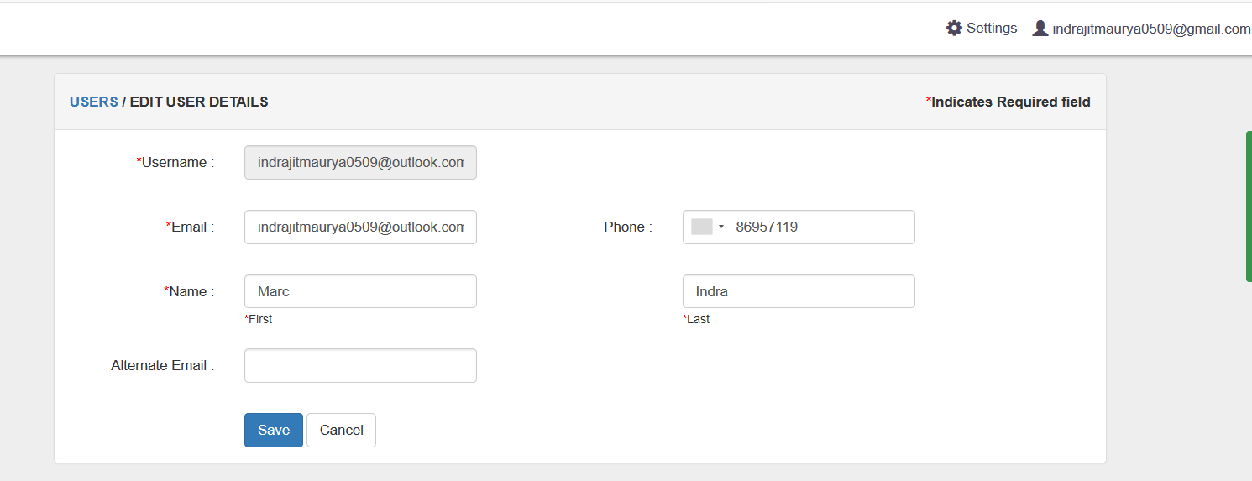
Activants Service Provider
Add users in IDP
admin
user

Slide 12
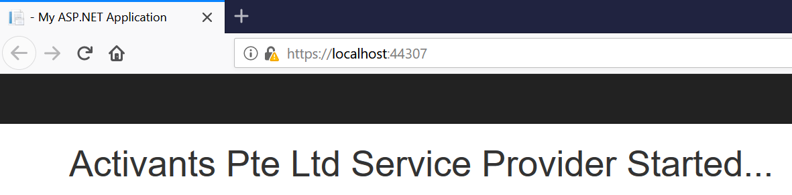
Activants Service Provider
Web Service Application

Slide 13
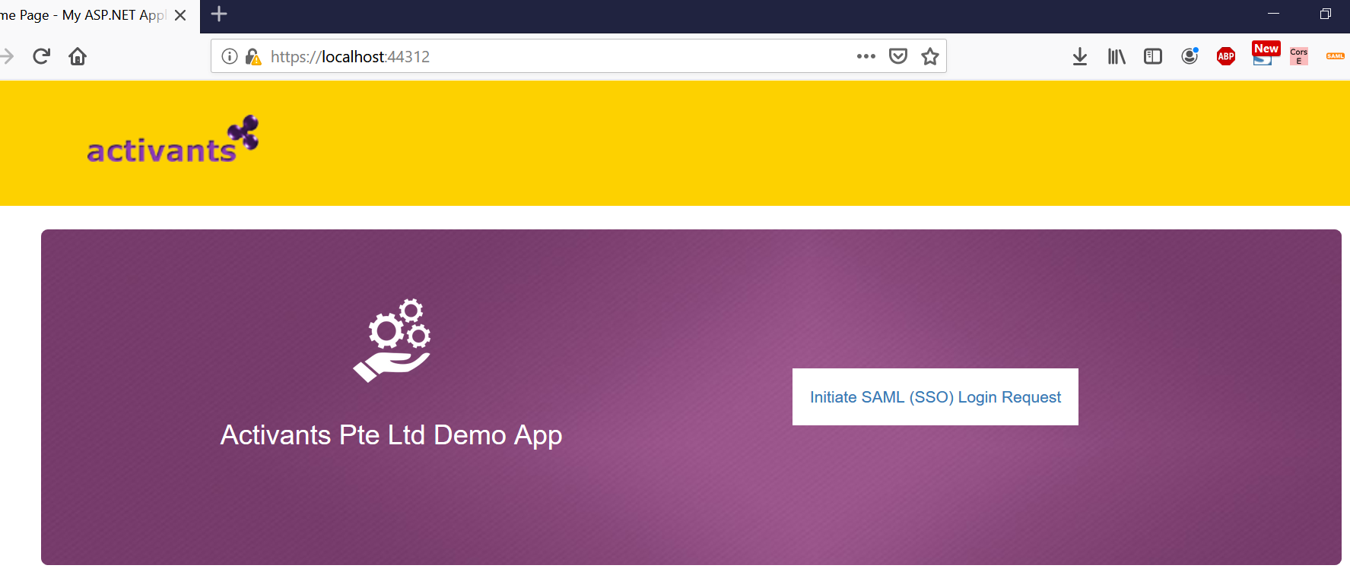
Activants Service Provider
Demo application

Slide 14
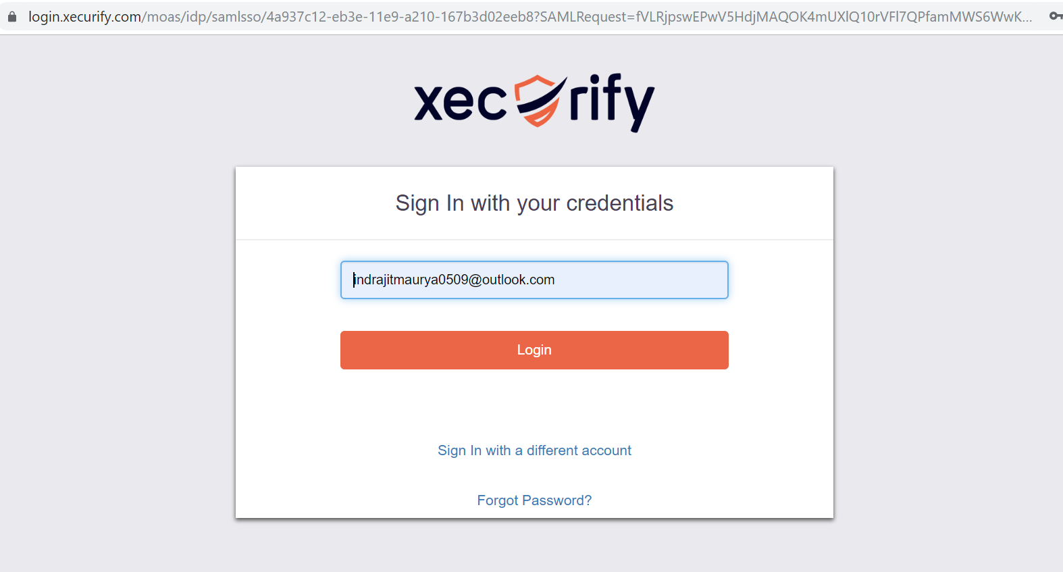
Activants Service Provider
Demo application (redirecting to IDP via SP)
On click of Initiate SSO
Users are redirected to
IDP login page for
authentication.

Slide 15
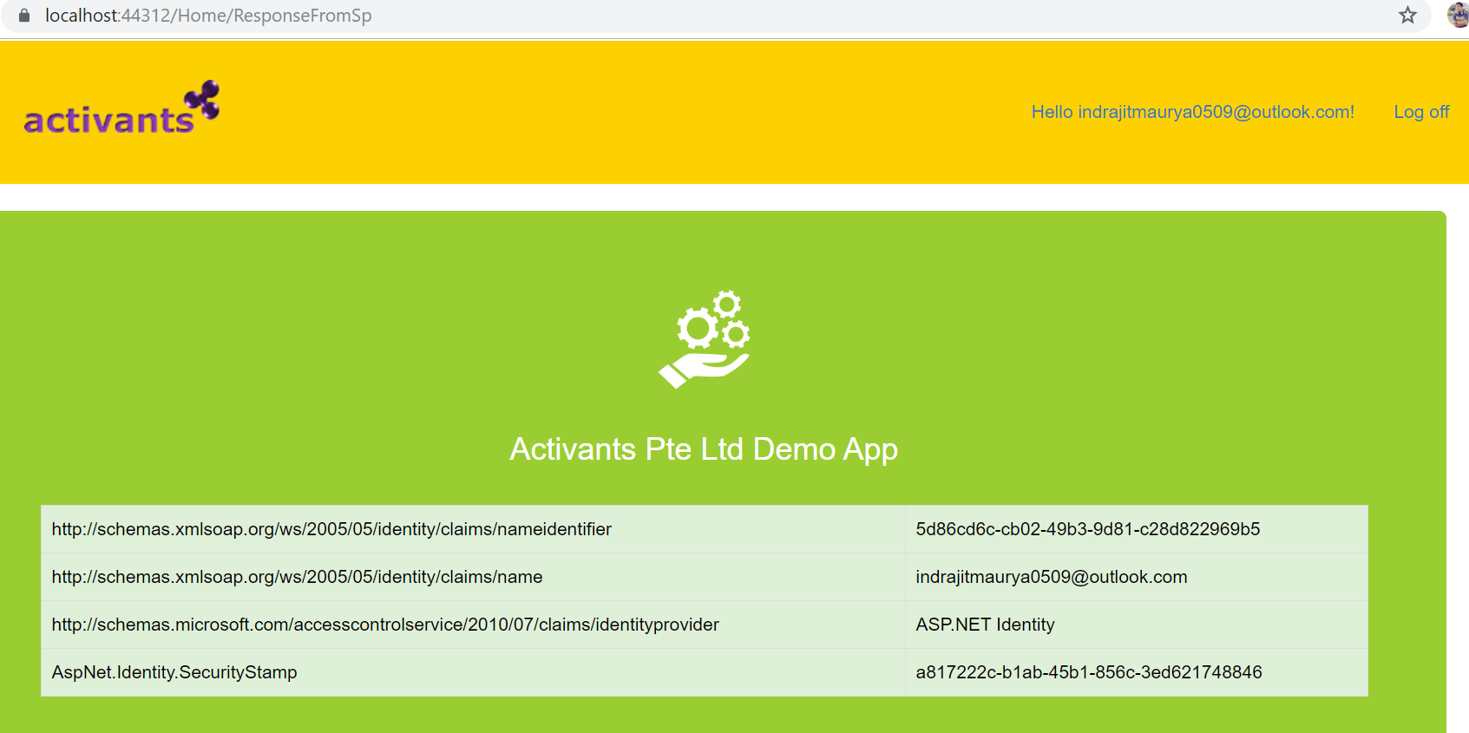
Activants Service Provider
Demo application (Response from IDP)

Slide 16
Activants Service Provider
Enabling ForceAuthn
The ForceAuthn flag requests that the IdP authenticate the user even if they already have an authentication session.
However, xecurify.com does not honor this flag.
As a result users have can automatically sign in having active sessions in IDP.
I do belief that SingPass/CorpPass honor this Flag..

Slide 17
Activants Service Provider
Security
Demo app
Activants
Service Provider
Identity Provider
The security of packages are
taken care by us
Security of Request and response
are taken care by Component Space

Slide 18
Acting as SAML Service Provider
Pending
Trying to figure out which IDP honours ForceAuthn flags
Fixing RelayState for multiple request
Security at Demo app and SP
Figuring out any bugs

Slide 19


